Slide 1


Laptop Price Prediction
Technical Analysis
About 90% of the World’s Currency Only Exists on Computers.

Slide 2

Table of Content
Problem Statement
Overview of Dataset
Data Wrangling
Exploratory Data Analysis
Algorithms and Machine Learning
Prediction
Future Scope and Motivation
Acknowledgement

Slide 3

Problem Statement
If any user wants to buy a laptop then our application should be compatible to provide a tentative price of laptop according to the user configurations.

Slide 4

Dataset
Kaggle Dataset
1300+ laptops records
12 features
Noisy Columns, contain lots of information
The only problem is we are having less data but we will obtain a good accuracy over it. The only good thing is. it is better to have a large data.

Slide 5

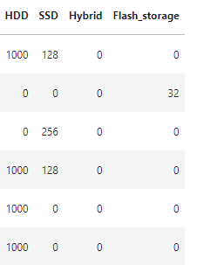
Data Wrangling
Storage Type
Storage Capacity
Feature Engineering
SSD + HHD
Storage capacity units

Slide 6
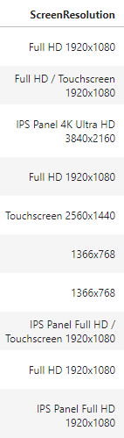
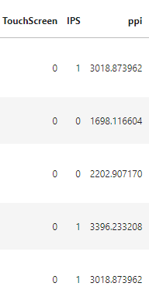
Data Wrangling
Touchscreen
Feature Engineering
IPS
Screen Resolution
dddd X dddd

Slide 7



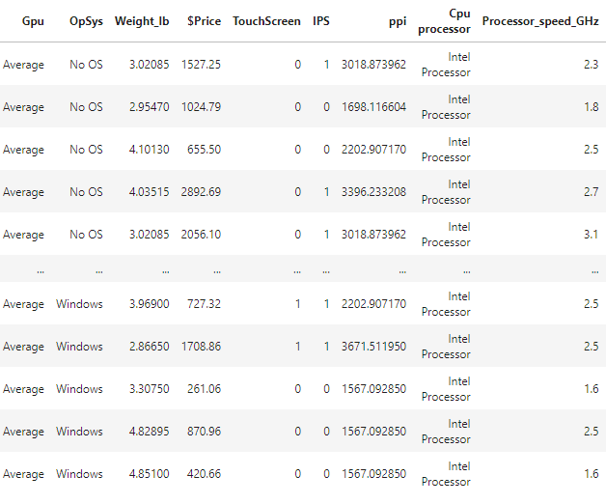
Data Wrangling
Feature Engineering

Slide 8

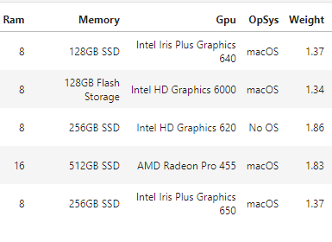
Data Wrangling
Feature Engineering

Slide 9
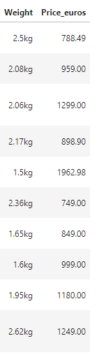
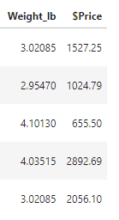
Data Wrangling
1 kg ≈ 2.205
Feature Engineering
1 Euro ≈ 1.14 USD

Slide 10
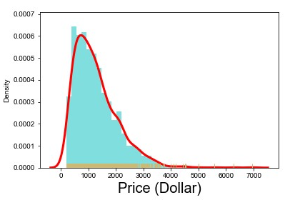
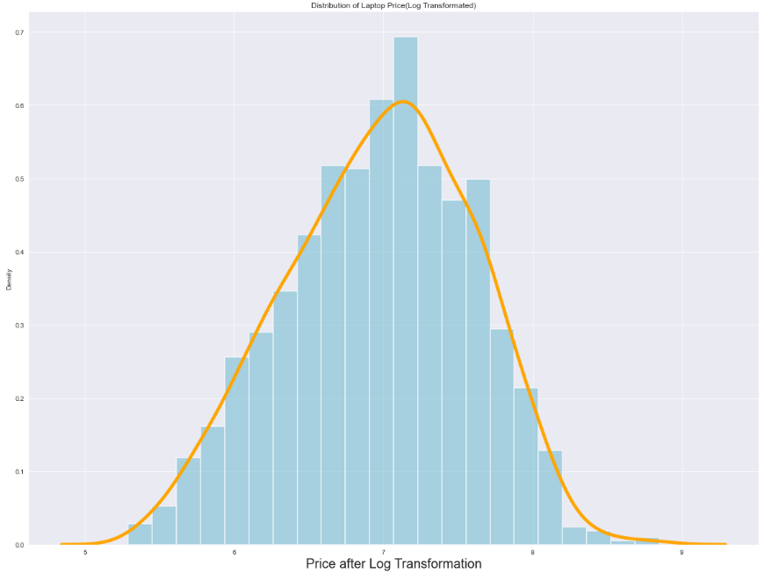
Exploratory Data Analysis
Log Transformation
Skewed Target variable
Normal Target variable

Slide 11
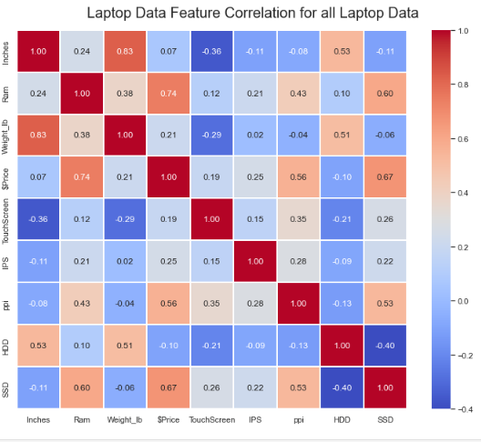
Algorithms and Machine Learning
ρ = Corr (Price, RAM)
ρ = Corr (Price, SSD)

Slide 12
Algorithms and Machine Learning
Name of the Algorithm | R2 Percentage | Mean Absolute Error
Linear Regression | 79.07% | 0.23
Ridge Regression | 79.09% | 0.23
Lasso Regression | 79.12% | 0.23
K Nearest Neighbor | 82.90% | 0.20
Decision Tree | 81.42% | 0.21
Random Forest | 88.09% | 0.17
Gradient Boosting | 89.60% | 0.16
Support Vector Regression | 89.59% | 0.16

Slide 13
Prediction
By taking various features like Storage size, Storage Capacity, processor speed (GHz), Company Name, etc.; you can predict price of your desired laptop!
Future Scope
Use different Techniques of Encoding Data
Hyper-parameter tunning can improve the performance.
Motivation
Although it looks like a simple project or just developing a model, the dataset we have is noisy and needs lots of feature engineering, and preprocessing that will drive your interest in developing this project. Laptop Price Prediction is an important problem. With a successful model for Laptop Price Prediction, we can choose better option! The motivated idea is that, if we know all information about laptop’s features, the price is predictable. In 2021, 340 million laptops are forecast to be shipped; this project is for all those 340 million lives!

Slide 14
Acknowledgement
I would like to Thank You
Travis Oliphant for maintaining NumPy library,
Wes McKinney for maintaining Pandas library,
John D. Hunter for inventing Matplotlib,
Michael Droettboom for maintaining Matplotlib,
Michael Waskom for creating Seaborn,
David Cournapeau for inventing Scikit-learn,
Daniel Wu for guiding me in this project.

Slide 15
Thank you!
Rutvimgohel@gmail.com
https://www.linkedin.com/in/rutvigohel-datascience/
https://github.com/PassionateDataScientist

